Slide 1
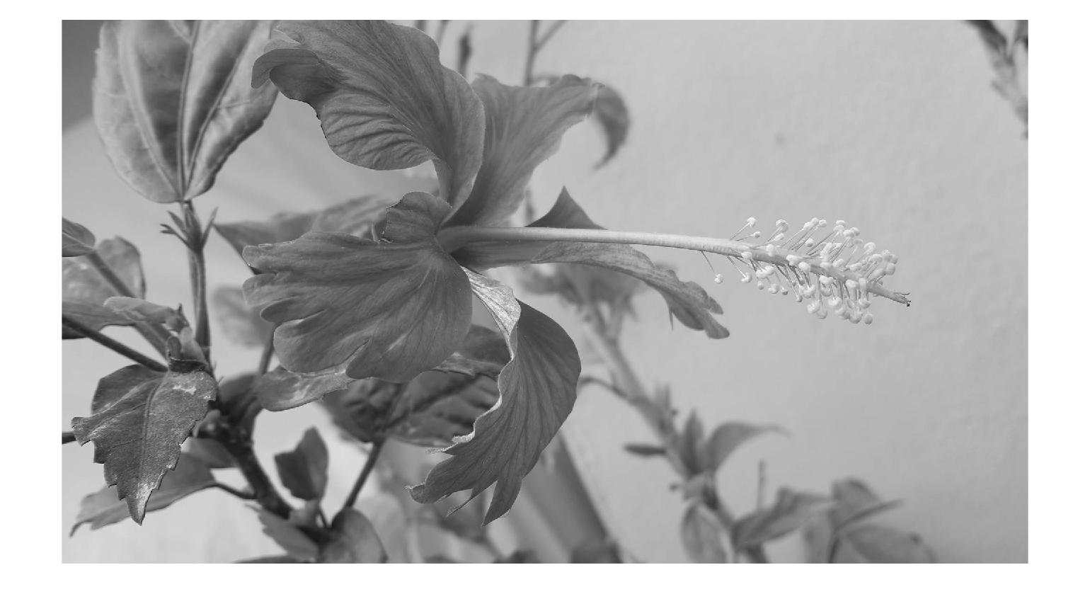
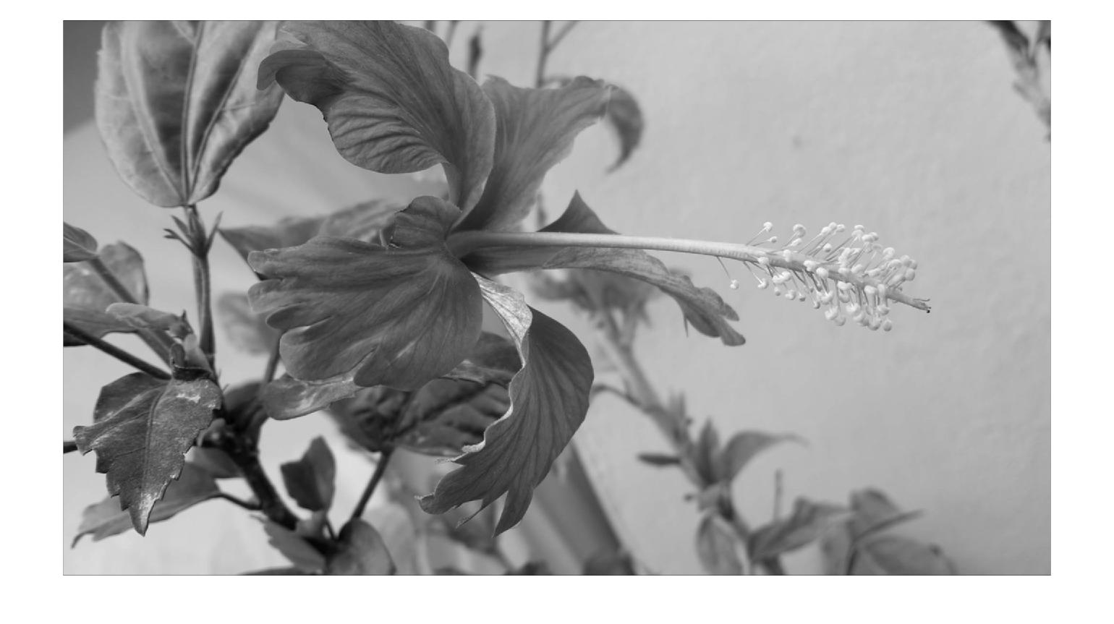
Filter Examples
Example 1:
  myFilter1 = [1 1 1; 1 1 1; 1 1 1];
  myOrigImage = rgb2gray(imread(‘Flower.jpg'));
  figure; imshow(myOrigImage);
  myFilteredImage = imfilter(double(myOrigImage),myFilter1);
  figure; imshow(myFilteredImage,[]);
03/20/24
CUI, Lahore Campus -- CSC 331: Digital Image Processing -- © Dr. Usama Ijaz Bajwa

Slide 2
Filter Examples
Example 2:
  myFilter2 = [0 0 0; 0 1 0; 0 0 0];
  myOrigImage = rgb2gray(imread(‘Flower.jpg'));
  figure; imshow(myOrigImage);
  myFilteredImage2 = imfilter(double(myOrigImage),myFilter2);
  figure; imshow(myFilteredImage2,[]);
03/20/24
CUI, Lahore Campus -- CSC 331: Digital Image Processing -- © Dr. Usama Ijaz Bajwa

Slide 3

Filter Examples (Slight Blur)
Example 3:
  myFilter3 = 1/13*[0 0 1 0 0; 0 1 1 1 0; 1 1 1 1 1; 0 1 1 1 0; 0 0 1 0 0];
  myOrigImage = rgb2gray(imread(‘Flower.jpg'));
  figure; imshow(myOrigImage);
  myFilteredImage3 = imfilter(double(myOrigImage),myFilter3);
  figure; imshow(myFilteredImage3,[]);
03/20/24
CUI, Lahore Campus -- CSC 331: Digital Image Processing -- © Dr. Usama Ijaz Bajwa

Slide 4

Filter Examples (Motion Blur)
Example 4:
  myFilter4 = 1/9*eye(9)
  myOrigImage = rgb2gray(imread(‘Flower.jpg'));
  figure; imshow(myOrigImage);
  myFilteredImage4 = imfilter(double(myOrigImage),myFilter4);
  figure; imshow(myFilteredImage4,[]);
03/20/24
CUI, Lahore Campus -- CSC 331: Digital Image Processing -- © Dr. Usama Ijaz Bajwa

Slide 5
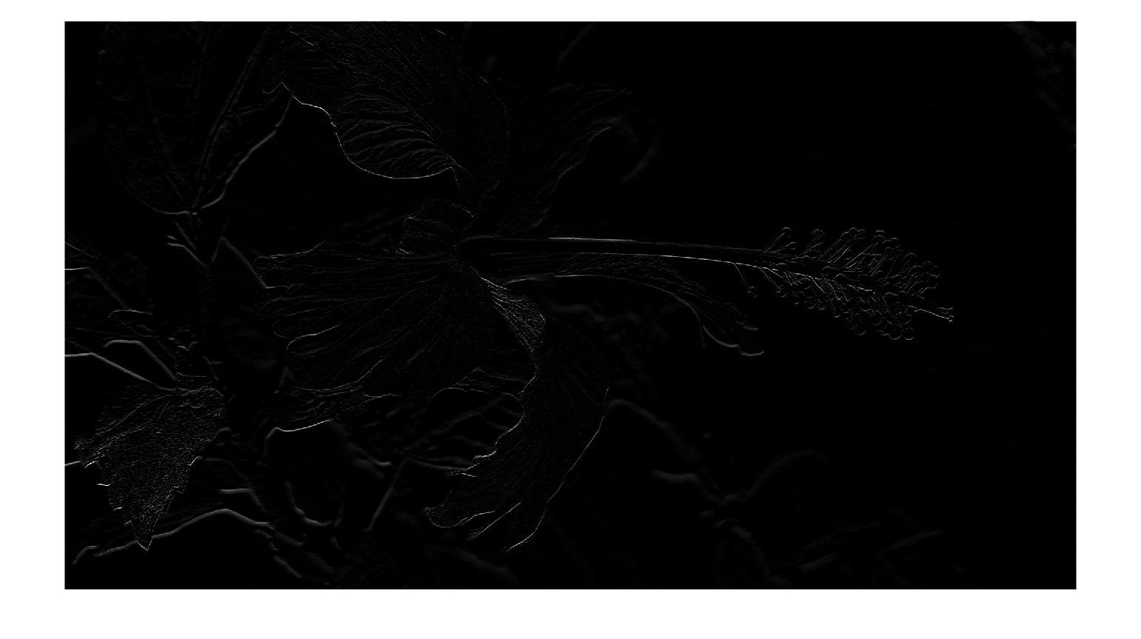
Filter Examples (Edges)
Example 5:
  myFilter5 = zeros (5,5);
  myFilter5(1:2,3) = -1;
  myFilter5(3,3) = 2
  myOrigImage = rgb2gray(imread(‘Flower.jpg'));
  figure; imshow(myOrigImage);
  myFilteredImage5 = imfilter(double(myOrigImage),myFilter5);
  figure; imshow(myFilteredImage5,[]);
03/20/24
CUI, Lahore Campus -- CSC 331: Digital Image Processing -- © Dr. Usama Ijaz Bajwa

Slide 6
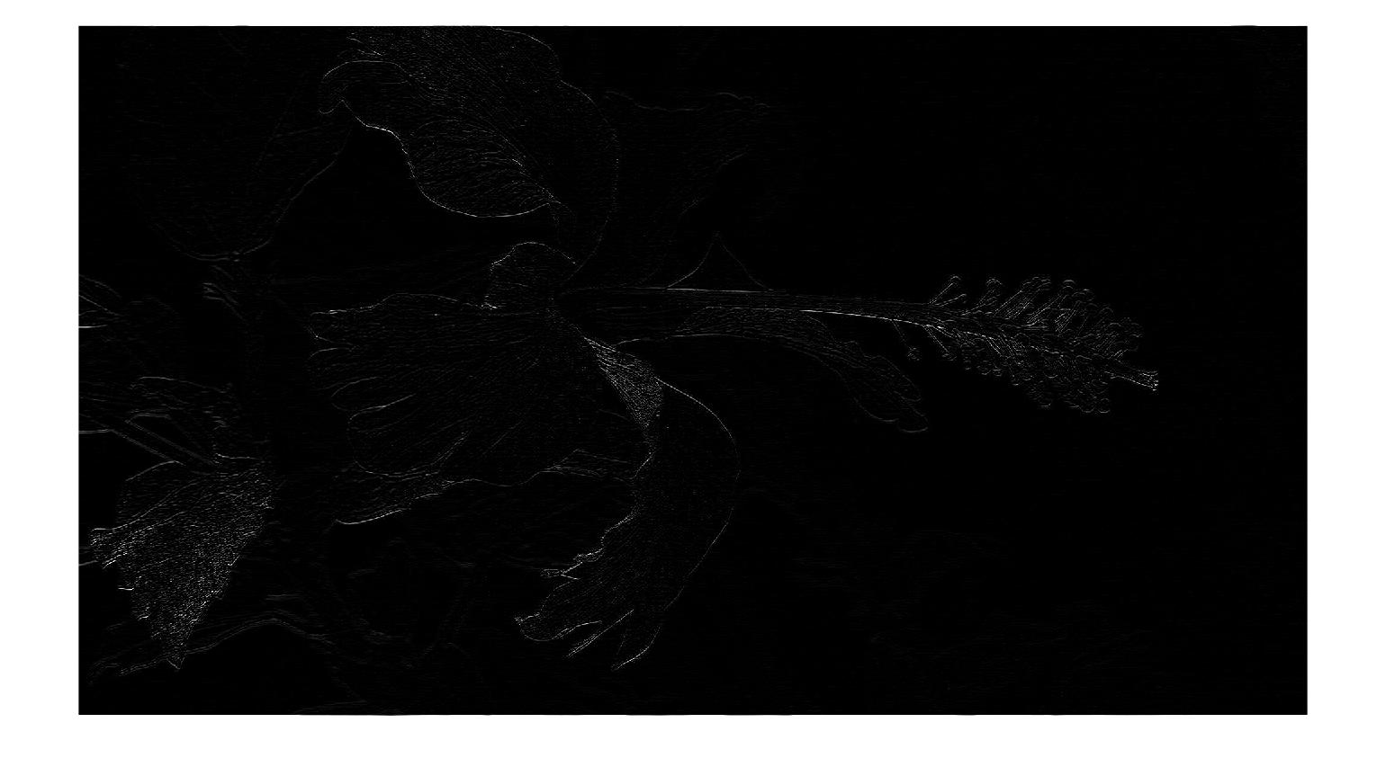
Filter Examples (Edges)
Example 6:
  myFilter6 = zeros (5,5);
  myFilter6(1:2,3) = -1;
  myFilter6(4:5,3) = -1;
  myFilter6(3,3) = 4;
  myOrigImage = rgb2gray(imread(‘Flower.jpg'));
  figure; imshow(myOrigImage);
  myFilteredImage6 = imfilter(myOrigImage,myFilter6);
  figure; imshow(myFilteredImage6,[]);
03/20/24
CUI, Lahore Campus -- CSC 331: Digital Image Processing -- © Dr. Usama Ijaz Bajwa

Slide 7
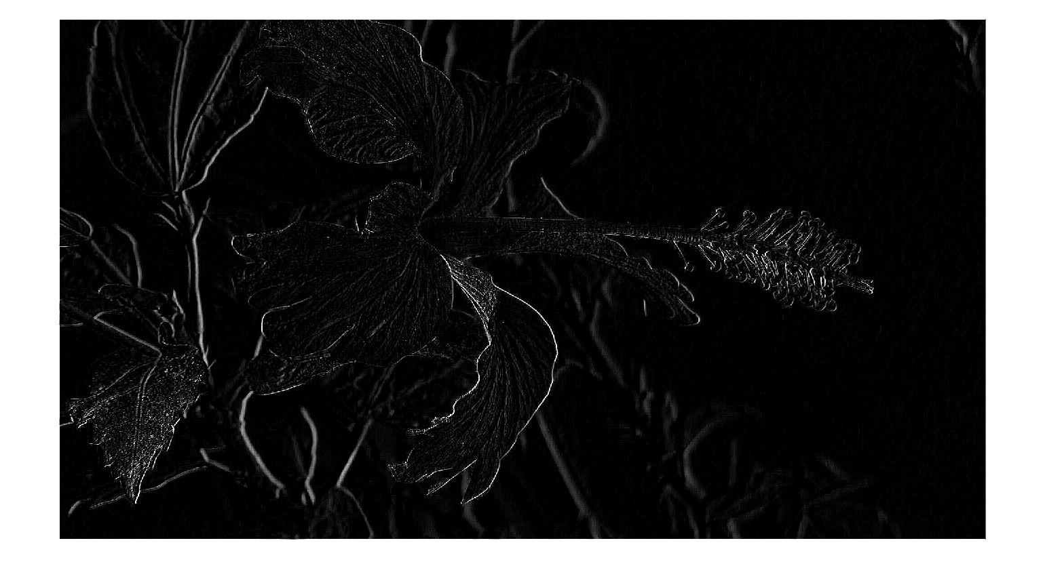
Filter Examples (Edges)
Example 7:
  myFilter7 = [-1 -1 -1; -1 8 -1; -1 -1 -1];
  myOrigImage = rgb2gray(imread(‘Flower.jpg'));
  figure; imshow(myOrigImage);
  myFilteredImage7 = imfilter(myOrigImage,myFilter7);
  figure; imshow(myFilteredImage7,[]);
03/20/24
CUI, Lahore Campus -- CSC 331: Digital Image Processing -- © Dr. Usama Ijaz Bajwa

Slide 8

Filter Examples (Edges)
Example 8:
  myFilter8 = [-1 -1 -1; -1 9 -1; -1 -1 -1];
  myOrigImage = rgb2gray(imread(‘Flower.jpg'));
  figure; imshow(myOrigImage);
  myFilteredImage8 = imfilter(myOrigImage,myFilter8);
  figure; imshow(myFilteredImage8,[]);
03/20/24
CUI, Lahore Campus -- CSC 331: Digital Image Processing -- © Dr. Usama Ijaz Bajwa

Slide 9

Filter Examples (Emboss)
Example 9:
  myFilter9 = [-1 -1 0; -1 0 1; 0 1 1];
  myOrigImage = rgb2gray(imread(‘Flower.jpg'));
  figure; imshow(myOrigImage);
  myFilteredImage9 = imfilter(myOrigImage,myFilter9);
  figure; imshow(myFilteredImage9,[]);
03/20/24
CUI, Lahore Campus -- CSC 331: Digital Image Processing -- © Dr. Usama Ijaz Bajwa

